Slide 1
Machine Learning Foundations and Applications
Jiaul Paik

Slide 2
Today’s Topics
Unsupervised Learning: Graph Clustering
Minimum cut
Hierarchical clustering
Spectral Clustering

Slide 3
Clustering Graph/Network Data

Slide 4
Graph/Network Data
So far we talked about data as n-dimensional point
What about the following?
Facebook friendship network
Communities in question-answering website like Quora
Protein interaction network

Slide 5

Facebook Friendship Graph/Network

Slide 6
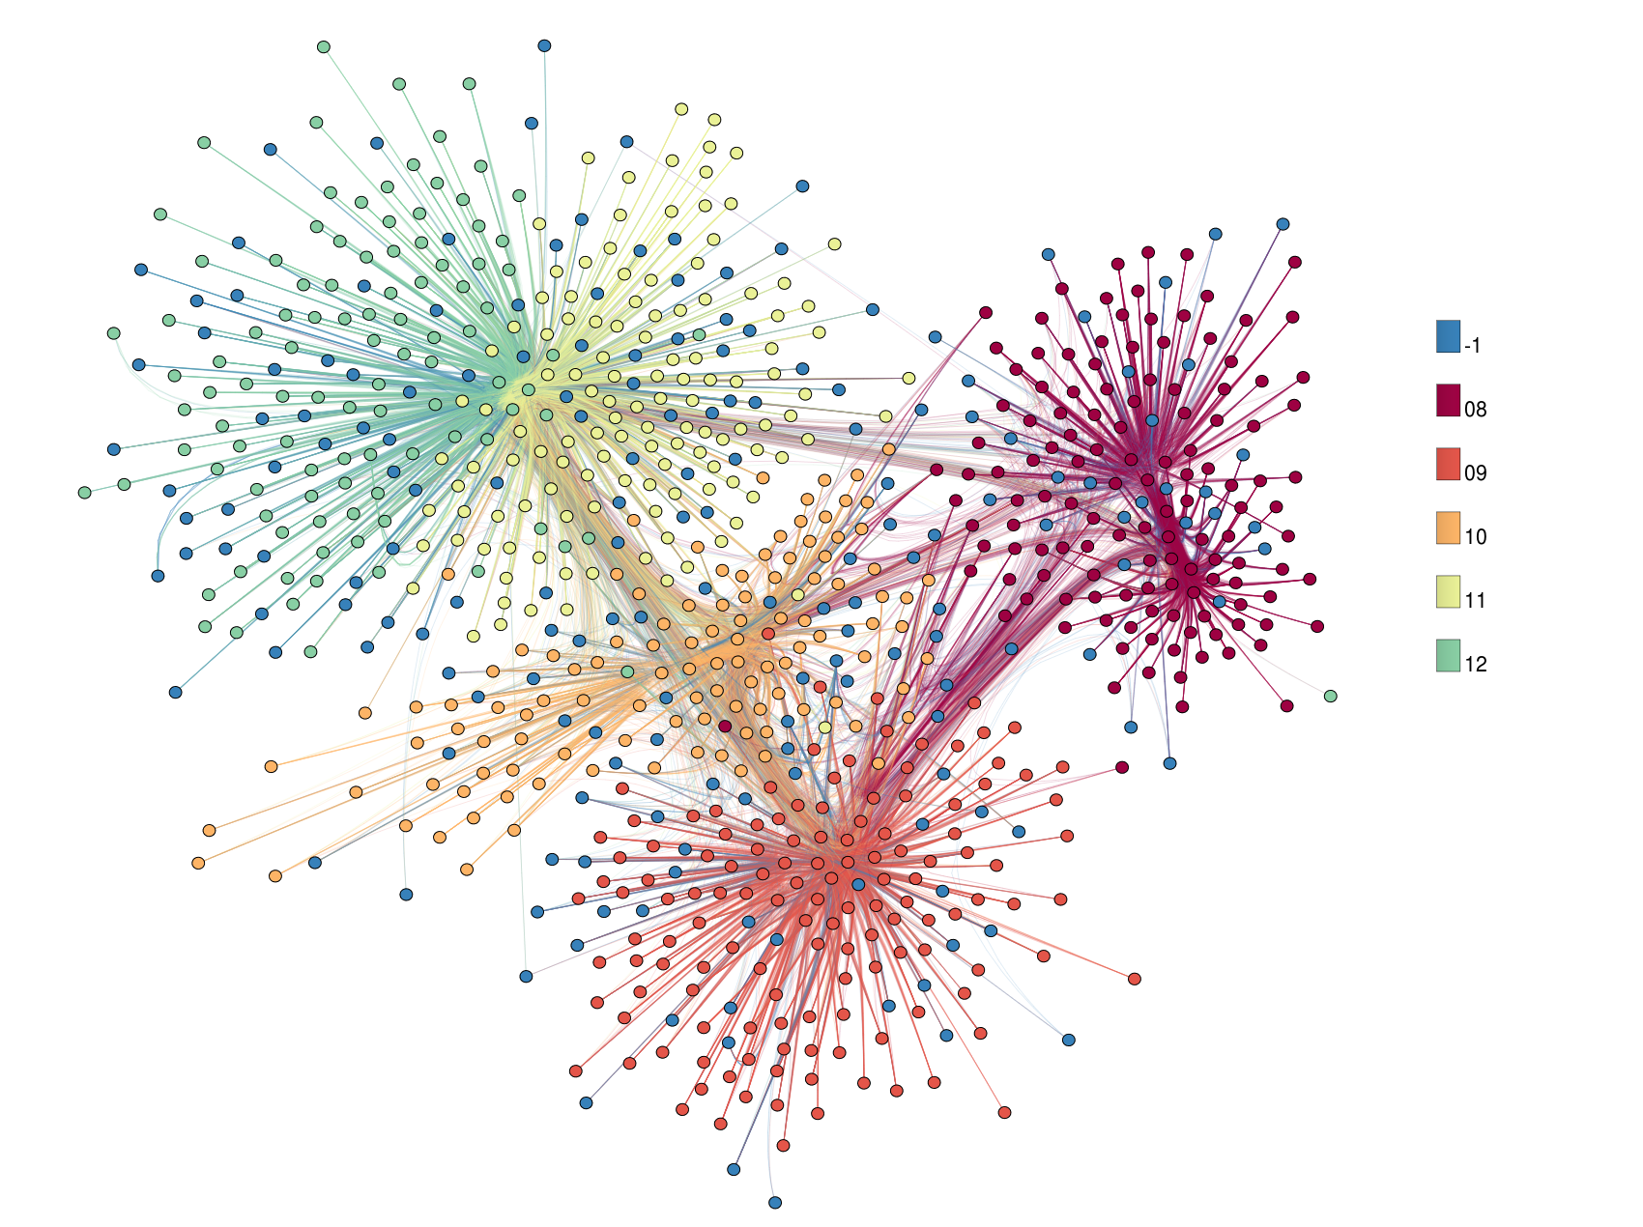
Problem You Want to Solve
Find coherent groups
friend circles in Facebook
Group similar objects
So, essentially, it is again a grouping problem with different type of data

Slide 7
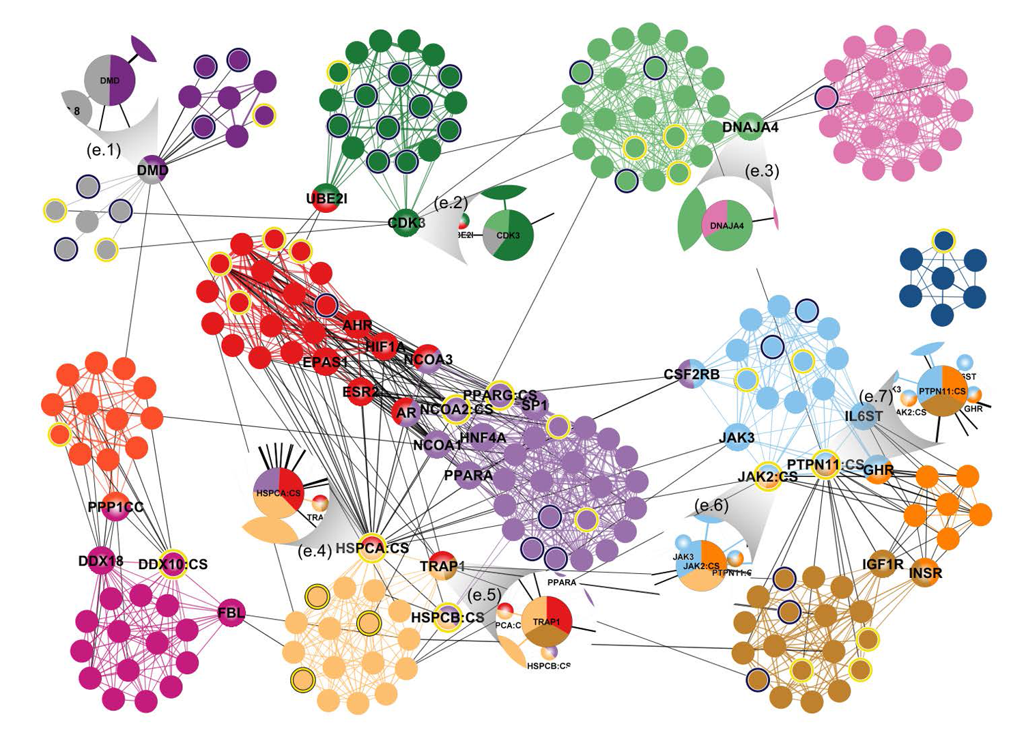
Example: Protein Interaction Network

Slide 8
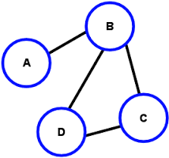
What is Graph?
A graph is composed of two things
Set of objects (called nodes of the graph)
Set of connections (called edges of the graph)
node
edge

Slide 9
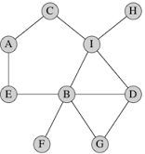
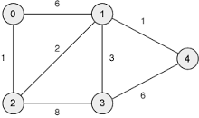
Types of Graph
Un-weighted
Edges do not have weight
Edges simply say whether two objects
are connected or not.
Weighted
Edges have weight
Examples:
Email communication network
How often two persons exchanging emails?
City and Road network
Edge weight: the distance between two cities

Slide 10
Graph Data
Graph data shows relationship between object pairs
Therefore, centroid is often not valid in graph
What does centroid mean in your Facebook friend network?
How do you define the center in a graph?

Slide 11
Clustering Un-weighted Graph

Slide 12
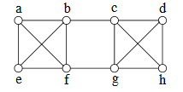
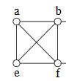
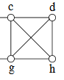
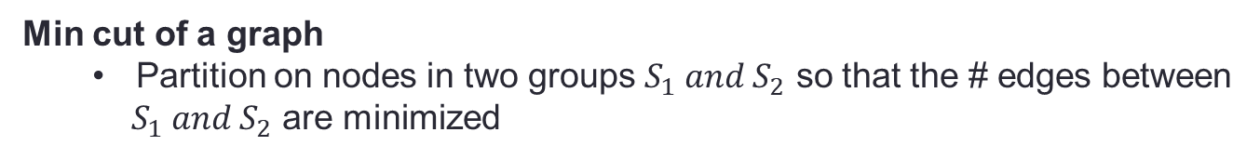
Graph Clustering: Minimum Cut (or Mincut)
Min cut of a graph
Partition on nodes in two groups $S_{1} and S_{2}$ so that the # edges between
$S_{1} and S_{2}$ are minimized
Example
For the above graph, the min cut partition is {a,b,e,f} and {c,d,g,h}

Slide 13
Graph Clustering using Mincut
Use a min cut algorithm to break a graph into two sets
Use the min cut algorithm to further break the smaller graphs
Continue until the stopping condition is satisfied

Slide 14
Karger’s Min Cut Algorithm
The algorithm is based on edge contraction
Repeat until just two nodes remain
Pick an edge at random
Collapse its two endpoints into a single node

Slide 15
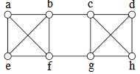
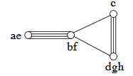
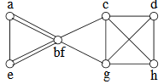
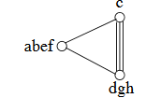
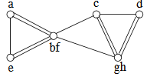
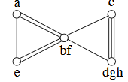
Karger’s Min Cut Algorithm: Example
14 edges to choose from
Pick b –f with prob 1/14
9 edges to choose from Pick ae – bf with prob 4/9
13 edges to choose from
Pick g - h with prob 1/13
5 edges to choose from
Pick c - dgh with prob 3/5
12 edges to choose from
Pick d - gh with prob 2/12
DONE: just two nodes
10 edges to choose from
Pick a - e with prob 1/10
Min cut value:
# of parallel edges in the final two-node graph
For this example: min cut is 2

Slide 16
Karger’s Min Cut Algorithm
An Important Note
It is a randomized algorithm
Therefore, for good result do the following
Run Karger’s algorithm multiple times
(it will produce multiple cuts)
Take the cut with minimum value

Slide 17
Clustering Weighted Graph

Slide 18
Hierarchical Clustering algorithms
Agglomerative (bottom-up)
Start with each object being a single cluster
Gradually merge two most similar clusters
Divisive (top-down)
Start out with all objects in the same cluster.
Then in each step of the algorithm do the following
Partition the cluster into two smaller clusters maximizing the distance

Slide 19
Hierarchical Clustering: Important Notes
Does not require the number of clusters in advance
Needs a termination/readout condition
Could be distance threshold

Slide 20
Rest of the Lecture
Hierarchical Agglomerative Clustering (HAC)
And for simple reasons
Simpler
Widely used

Slide 21
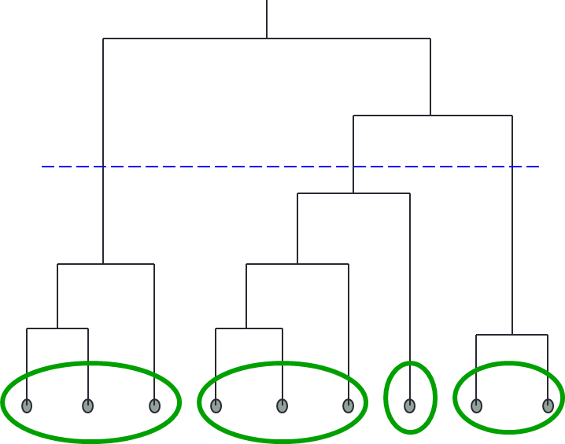
Hierarchical Agglomerative Clustering (HAC)
Define a similarity function for determining the similarity of two instances.
Starts with all instances in a separate cluster
Then repeatedly joins the two clusters that are most similar
The history of merging forms a hierarchy (called dendogram).

Slide 22
Hierarchical Clustering
The important question
How do you determine the “nearness” of clusters?

Slide 23
Closest pair of clusters
Many variants to defining closest pair of clusters
Single-link
Distance of the “closest” points (single-link)
Complete-link
Distance of the “furthest” points
Average-link
Average distance between pairs of elements

Slide 24
Single Link Agglomerative Clustering
Use maximum similarity of pairs:
3
6
4
10
Cluster 1
Cluster 2
Distance between Cluster 1 and 2: 3

Slide 25
Single Link Example

Slide 26
Problem with Single Link Clustering
Chain or elongated clusters
They are far apart, yet they are in the same cluster

Slide 27
Complete Link Agglomerative Clustering
Use minimum similarity of pairs:
Makes “tighter,” spherical clusters that are typically preferable.
3
6
4
10
Cluster 1
Cluster 2
Distance between Cluster 1 and 2: 10

Slide 28
Complete Link Example

Slide 29
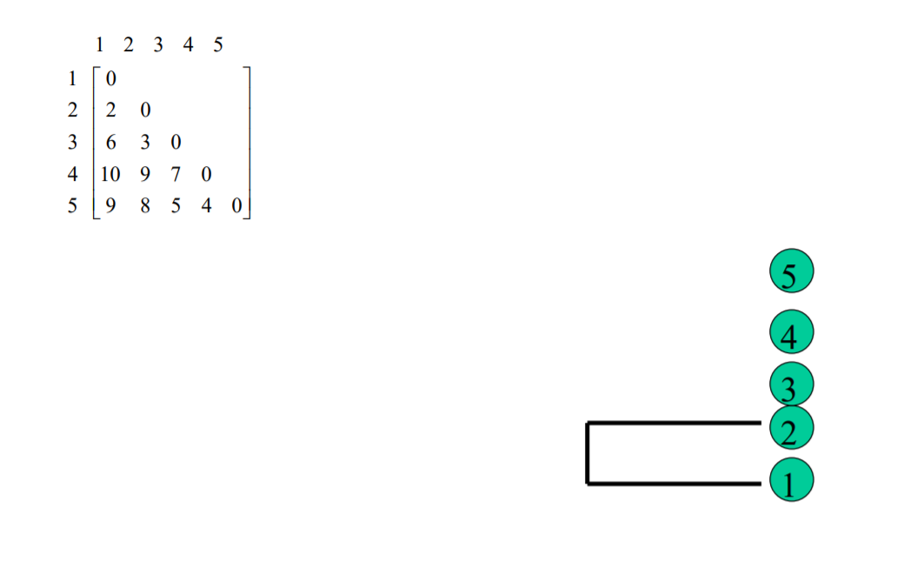
Example in Detail: Single Link Clustering

Slide 30
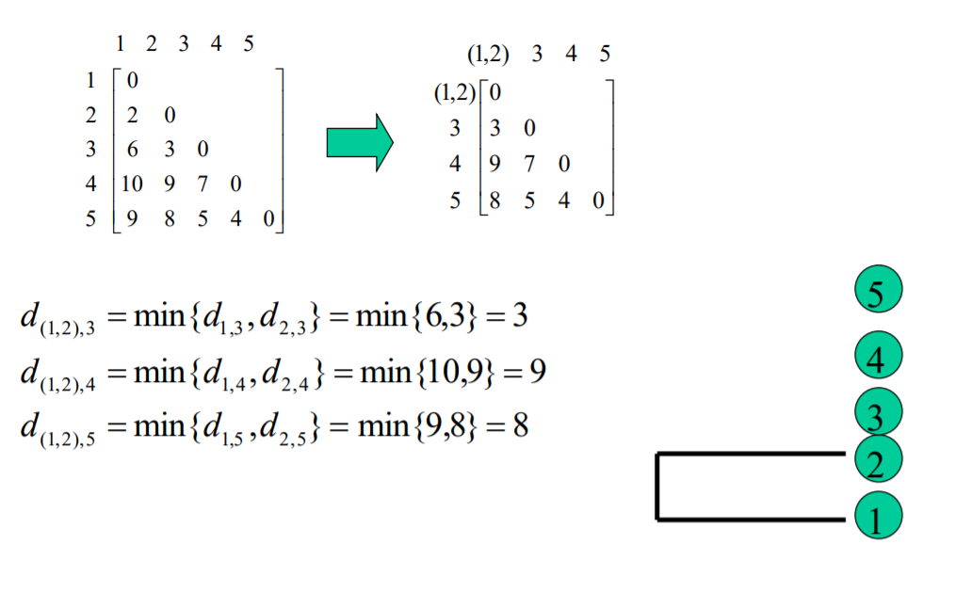
Example in Detail: Single Link Clustering

Slide 31
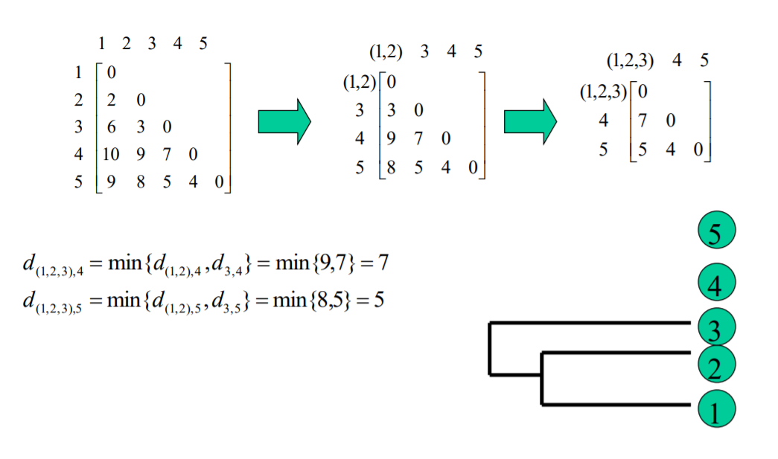
Example in Detail: Single Link Clustering

Slide 32
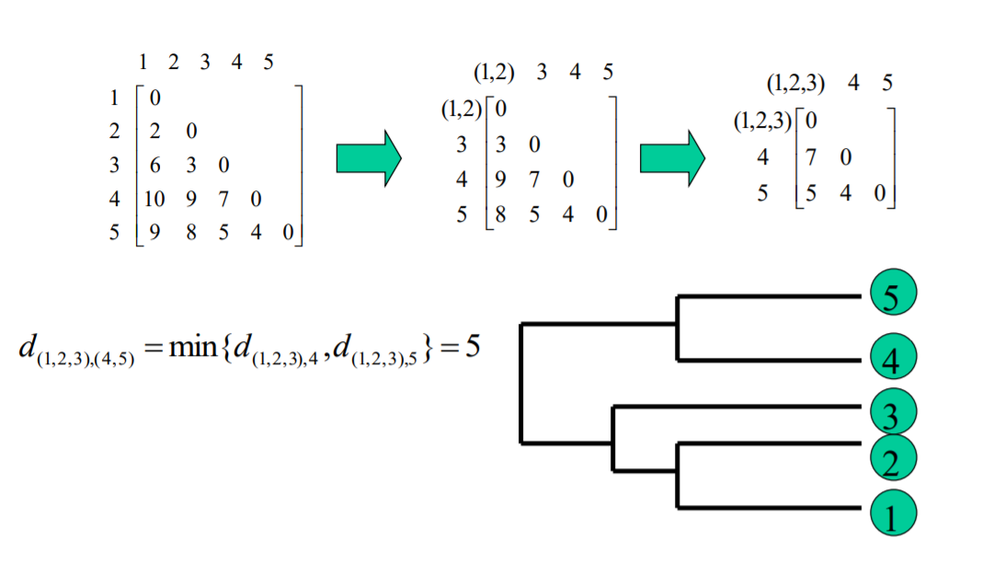
Example in Detail: Single Link Clustering

Slide 33
Spectral Clustering
Slides credit: David Sontag

Slide 34
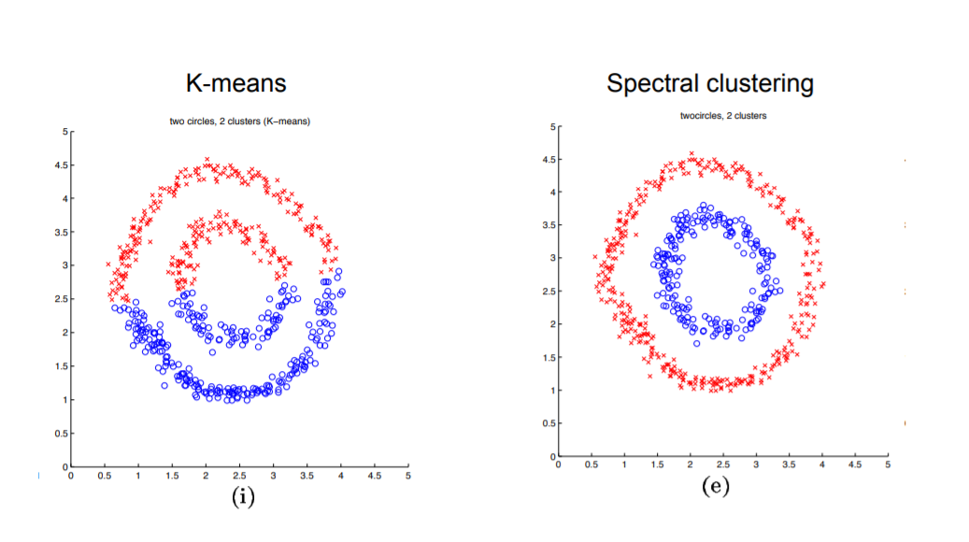
Spectral Clustering

Slide 35
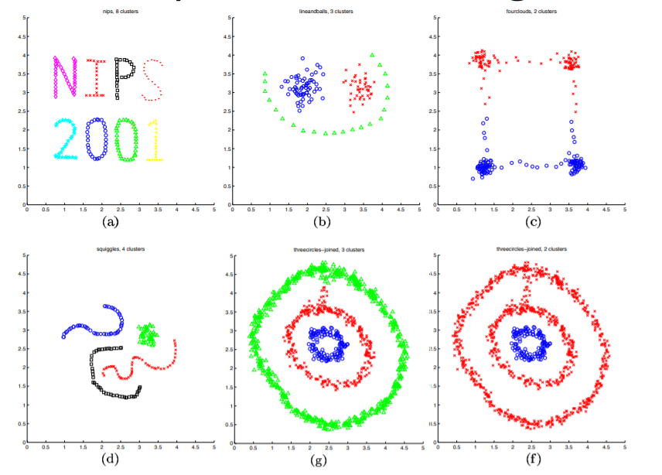
Spectral Clustering: Examples

Slide 36
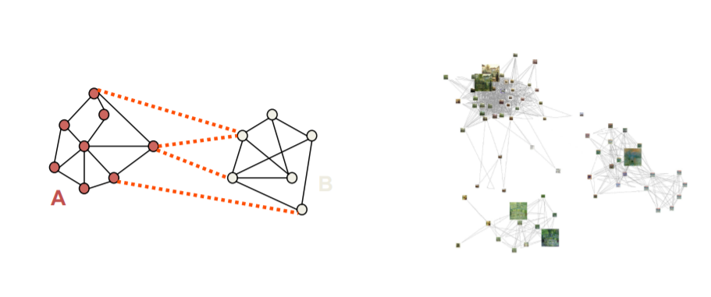
Spectral Clustering
Group points based on links in the graph

Slide 37
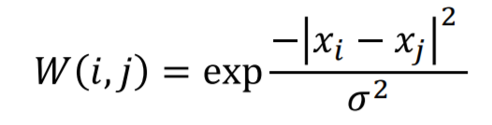
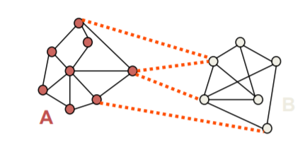
Creating Graph from n-dimensional data
Use Gaussian Kernel to compute similarity between objects i and j
Possible Graphs:
Fully connected
Connect only k-nearest neighbours

Slide 38
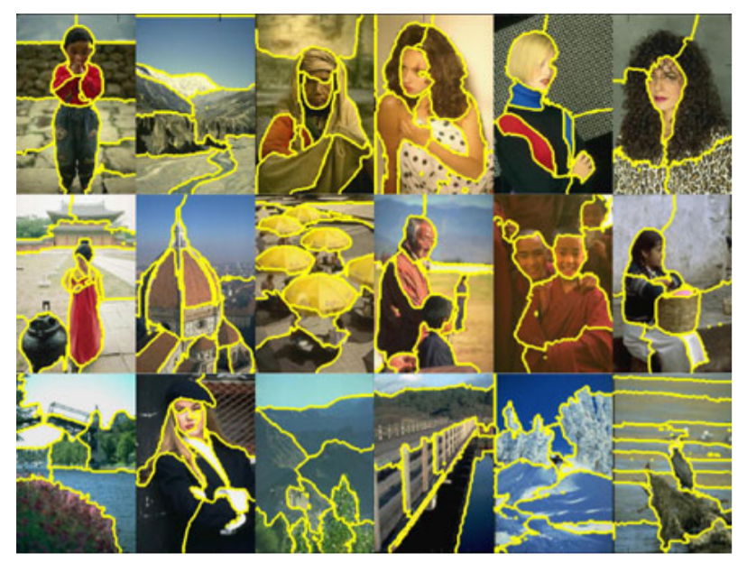
Image Segmentation

Slide 39
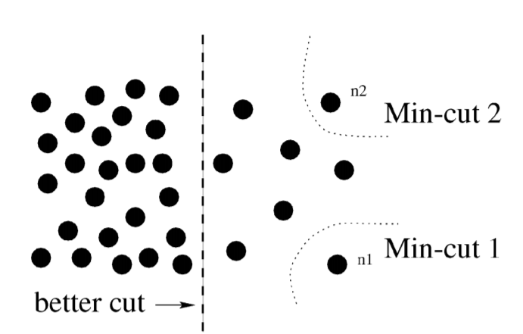
Why not minimum cut?

Slide 40
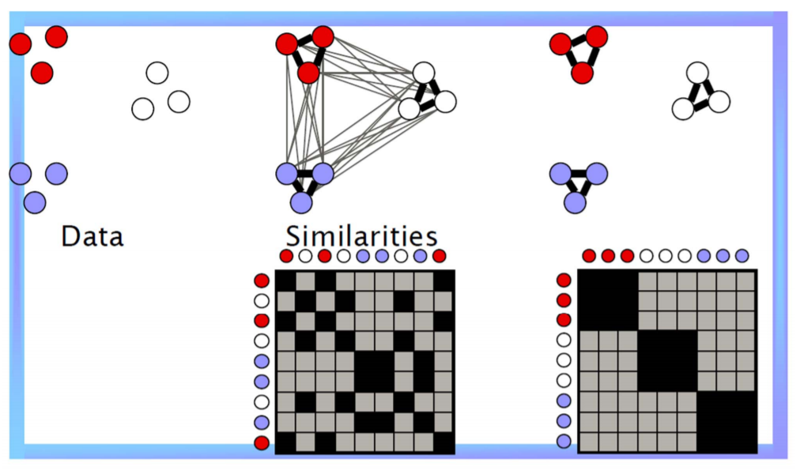
Graph Partitioning

Slide 41
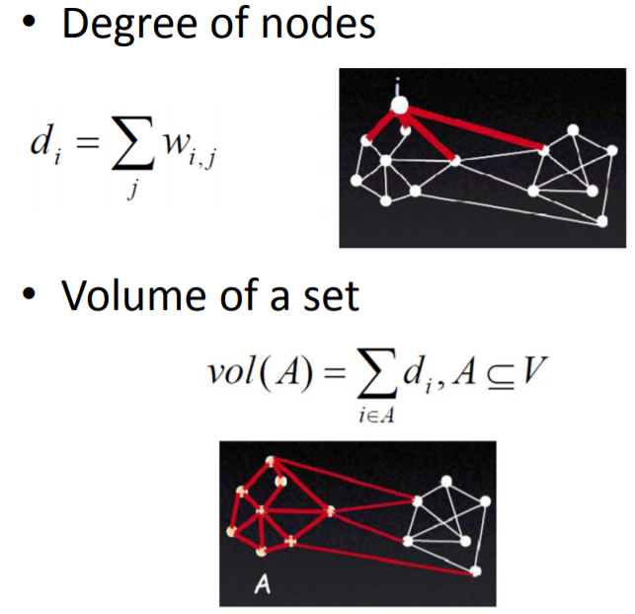
Useful Terminologies

Slide 42
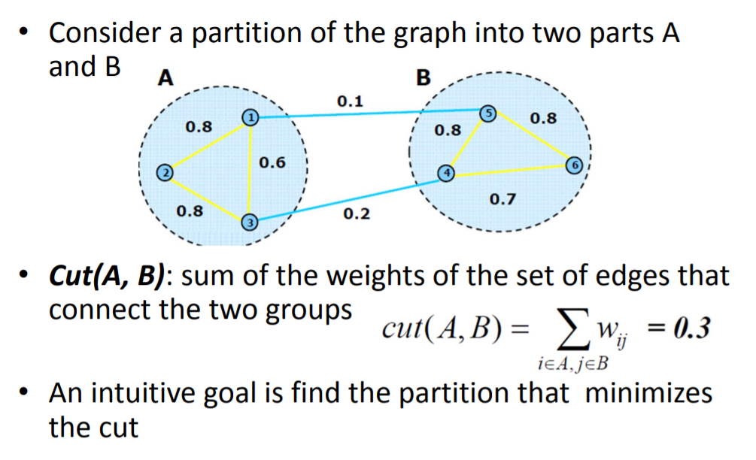
Graph Cut

Slide 43
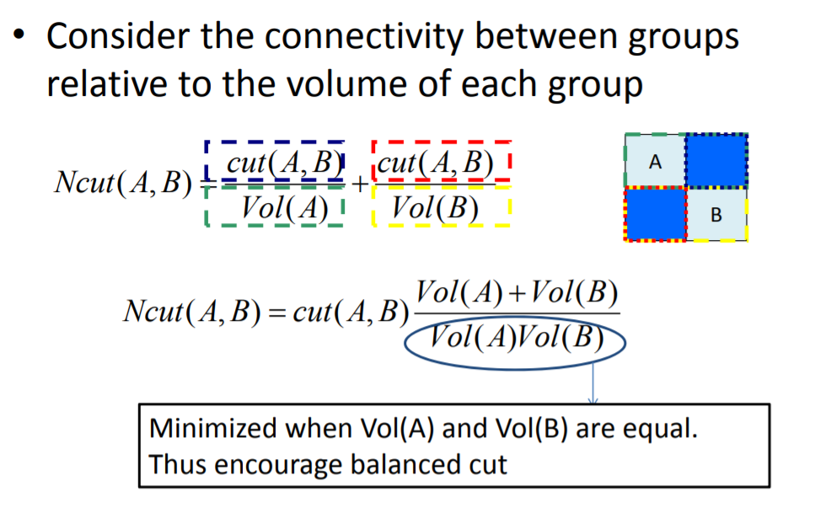
Normalized cut

Slide 44
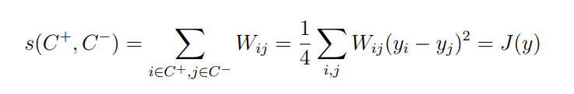
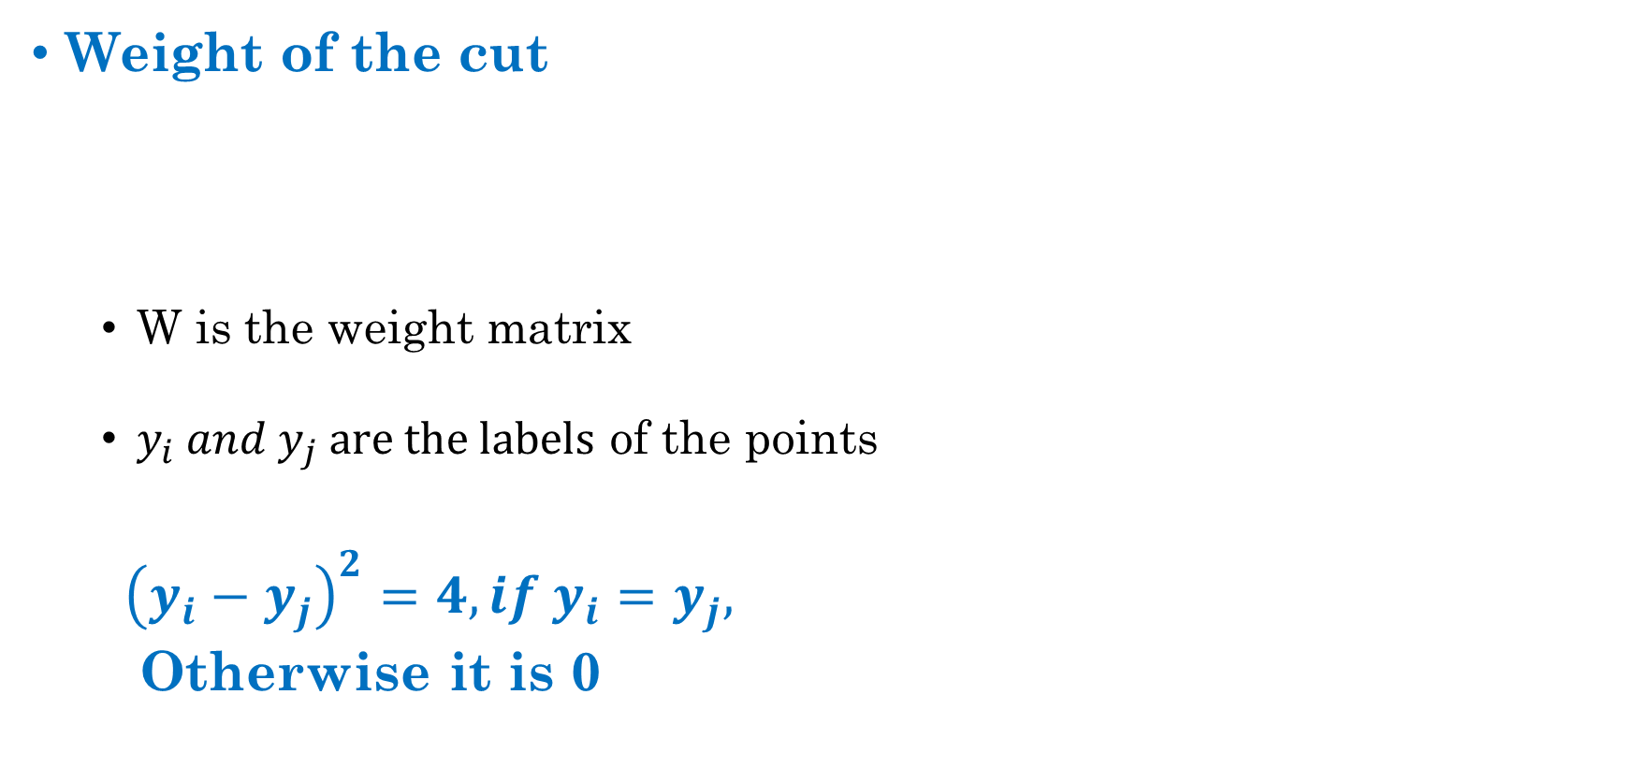
Solving Normalized Cut
Weight of the cut
W is the weight matrix
$y_{i} and y_{j} are the labels$ of the points
${\left(y_{i}−y_{j}\right)}^{2}=4, if y_{i}=y_{j},$
Otherwise it is 0

Slide 45
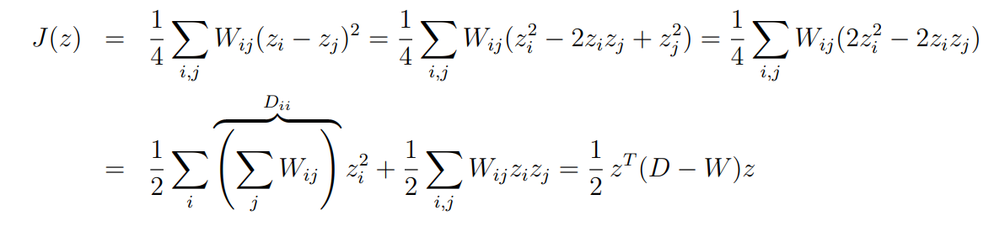
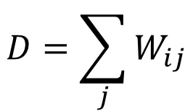
Solving Normalized Cut
$$D=\sum_{j}{W_{ij}}$$
(diagonal matrix)
D – W = L is called the Graph Laplacian
By property, L is positive semi-definite
The smallest eigenvalue is always 0 and the corresponding eigenvector is 1

Slide 46
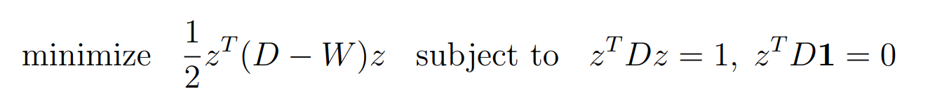
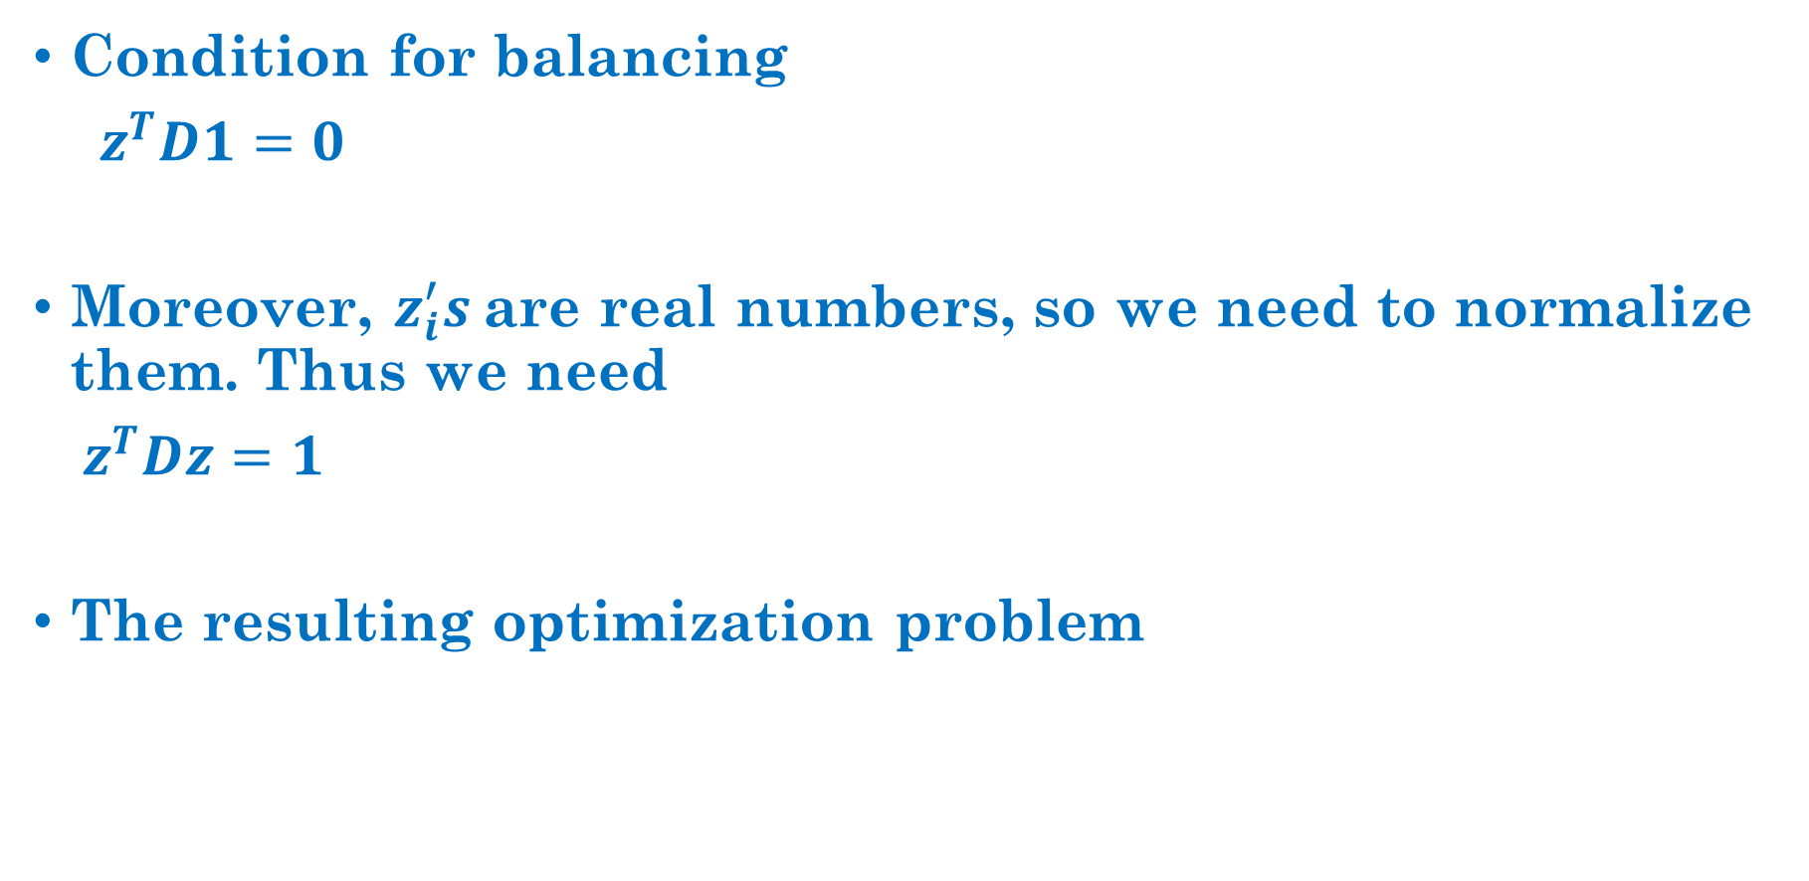
Solving Normalized Cut
Condition for balancing
$z^{T}D1=0$
Moreover, $z_{i}^{′}s$are real numbers, so we need to normalize them. Thus we need
$z^{T}Dz=1$
The resulting optimization problem

Slide 47
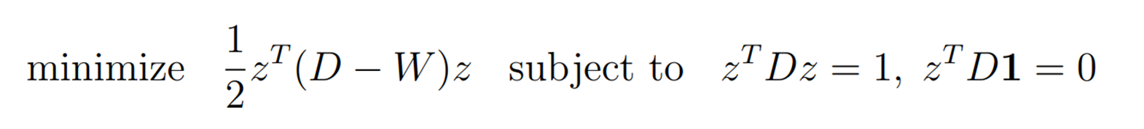
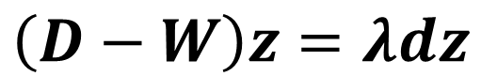
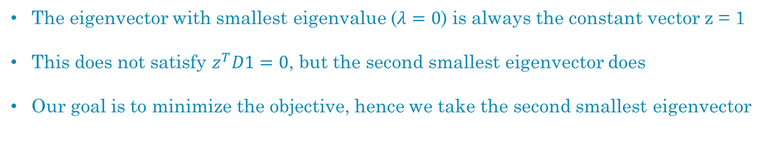
Solving Normalized Cut
One can easily find the following solution using Lagrange multiplier
$$\left(D−W\right)z=λdz$$
The eigenvector with smallest eigenvalue ($λ=0$) is always the constant vector z = 1
This does not satisfy $z^{T}D1=0$, but the second smallest eigenvector does
Our goal is to minimize the objective, hence we take the second smallest eigenvector

Slide 48
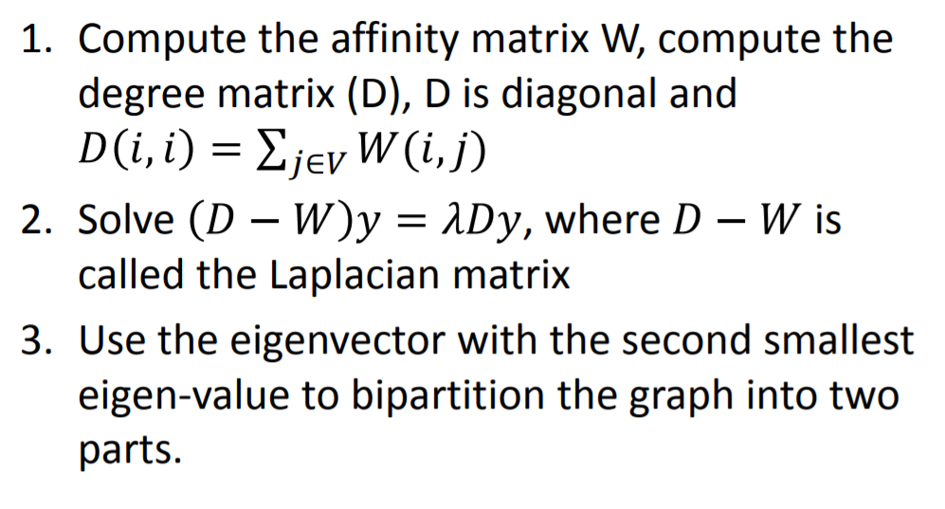
Two-way Normalized Cut

Slide 49
Portioning using 2nd Eigenvector
Second eigenvector takes continuous values
Difficult to find a clear threshold to split
How to choose splitting threshold?
Pick the median value as splitting point.
Look for the splitting point that has the minimum Normalized cut value:
Choose n possible splitting points.
Compute Normalized cut value.
Pick minimum.

